Slide 1
FACE MASK DETECTION USING CNN
PRESENTED BY:
S.EZHILMARAN
513121104004
THANTHAI PERIYAR GOVERNMENT INSTITUTE OF TECHNOLOGY,VELLORE
3/21/2024 Annual Review

Slide 2
PROJECT TITLE
FACE MASK DETECTION USING CNN
3/21/2024 Annual Review

Slide 3


AGENDA
1.Problem Statement 2.Project overview 3.End Users 4.Solutions and its Proposition 5.The WOW in the solution 6.Modelling 7.Results 8.Conclusion
3/21/2024 Annual Review

Slide 4

PROBLEM STATEMENT
Develop a machine learning model to detect whether a person is wearing a face mask or not in an image. The model should be able to accurately classify images into two classes: 'Mask' and 'No Mask'. This solution aims to assist in enforcing safety measures, such as mask-wearing, in public spaces
3/21/2024 Annual Review

Slide 5

PROJECT OVERVIEW
This project aims to develop a machine learning model for face mask detection using a dataset containing images of people with and without masks. The model will be based on the MobileNet architecture and will be trained to classify images into two categories: 'Mask' and 'No Mask'. The goal is to create a tool that can help enforce safety regulations, such as mask-wearing, in public places.

Slide 6

WHO ARE THE END USERS?
Public Health Authorities
Business Owner
Security Personnel
General Public

Slide 7
YOUR SOLUTION AND ITS VALUE PROPOSITION
The solution for the face mask detection project involves developing a machine learning model that can accurately detect whether a person is wearing a face mask in an image. The model will be trained on a dataset of images labeled with 'Mask' and 'No Mask' classes. The MobileNet architecture will be used as the base model, with additional layers added for fine-tuning.
Value Proposition:
Public Safety: The model can help ensure that people are following mask-wearing guidelines in public places, contributing to overall public health and safety.
Efficiency: Automated detection through the model is faster and more efficient than manual monitoring, especially in crowded areas.
Cost-Effectiveness: Implementing this solution can potentially save costs associated with manual monitoring and enforcement of mask-wearing policies.

Slide 8

THE WOW IN YOUR SOLUTION
The wow factor in this solution lies in its ability to leverage cutting-edge machine learning technology to address a pressing real-world issue. By using a deep learning model, the solution can achieve a high level of accuracy in detecting whether a person is wearing a face mask or not, even in diverse and challenging environments. This level of automation and accuracy can significantly enhance public safety efforts, particularly in the context of current global health challenges.
3/21/2024 Annual Review
8

Slide 9
MODELLING
1.Data Collection: Gather a dataset of images containing people with and without face masks.
2.Data Preprocessing: Resize the images to a uniform size (e.g., 224x224), normalize pixel values, and create labels for the images (e.g., 'Mask' or 'No Mask').
3.Model Selection: Choose a pre-trained deep learning model as a base (e.g., MobileNet) and add custom layers for fine-tuning.
4.Model Training: Split the dataset into training and testing sets. Train the model on the training set, adjusting the weights to minimize the loss function.
5.Model Evaluation: Evaluate the model's performance on the testing set using metrics like accuracy, precision, recall, and F1-score.
9

Slide 10
6.Model Optimization: Fine-tune the model by adjusting hyperparameters (e.g., learning rate, batch size) to improve performance.
7.Deployment: Deploy the trained model to a production environment, such as a web service or mobile application, for real-time inference.
8.Testing and Validation: Test the deployed model with new images to ensure it performs well in real-world scenarios.
9.Monitoring and Maintenance: Continuously monitor the model's performance and retrain it periodically with new data to maintain accuracy.
10.Feedback Loop: Gather feedback from users and stakeholders to identify areas for improvement and enhance the model's effectiveness over time.

Slide 11
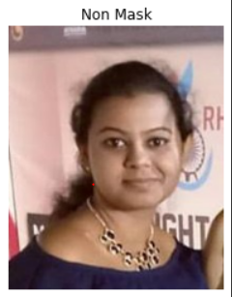
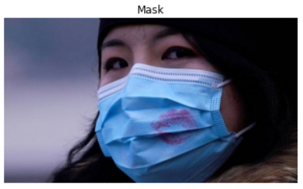
RESULTS
Person wear no mask
Person wear mask
11

Slide 12
CONCLUSION
In conclusion, the face mask detection project successfully developed a machine learning model capable of accurately detecting whether a person is wearing a face mask in an image. The model, based on the MobileNet architecture, achieved high accuracy and can be deployed in various real-world scenarios to enforce mask-wearing policies and contribute to public health and safety efforts.

Slide 13
THANK YOU

